Slide 1
CI/CD

Slide 2




How do we add/modify pages in a book?
Git solves a lot of our problems regarding to this issue, but how do we really accomplish this?
Let’s say I want to add couple of pages to one of the chapters
DevOps 101 .
Revision 1
DevOps 101 .
Revision 2
How to publish it effortlessly?

Slide 3
What is CI/CD?
CI/CD is a method to frequently deliver apps to customers by introducing automation into the stages of app development.
The main concepts attributed to CI/CD are continuous integration, continuous delivery, and continuous deployment.
CI/CD is a solution to the problems integrating new code can cause for development and operations teams (AKA "integration hell").

Slide 4
Development stages
CI
Plan
Code
Build
Test
Start over
Revision 1 completed
CD
Release
Deploy
Operate
Monitor
How to start working on Revision 2?

Slide 5
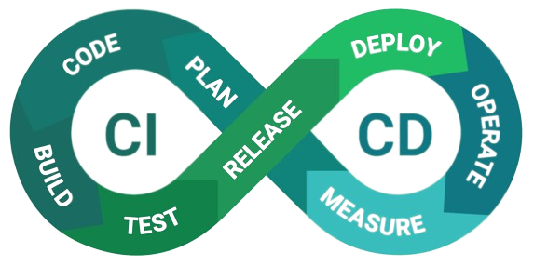
Let’s make it easier to eyes

Slide 6
Jenkins

Slide 7




Architecture
SSH
Static slaves
Jobs
Users
Plugins
Credentials
Nodes/Cloud
Global Configs
Dynamic slaves
Cloud API

Slide 8
How it work?
Jenkins Master
Jenkins Slave
Task Execution for job #1
Task Executor for job #1
Slave will be chosen according to provided config and a executor will be created on slave (over TCP/IP)
Any required config, env, … will pass to execution
Jenkins Slave
Task Execution for job #n
Task Executor for job #n

Slide 9

Jenkins Files
Build Sample
Deploy Sample

